Slide 3
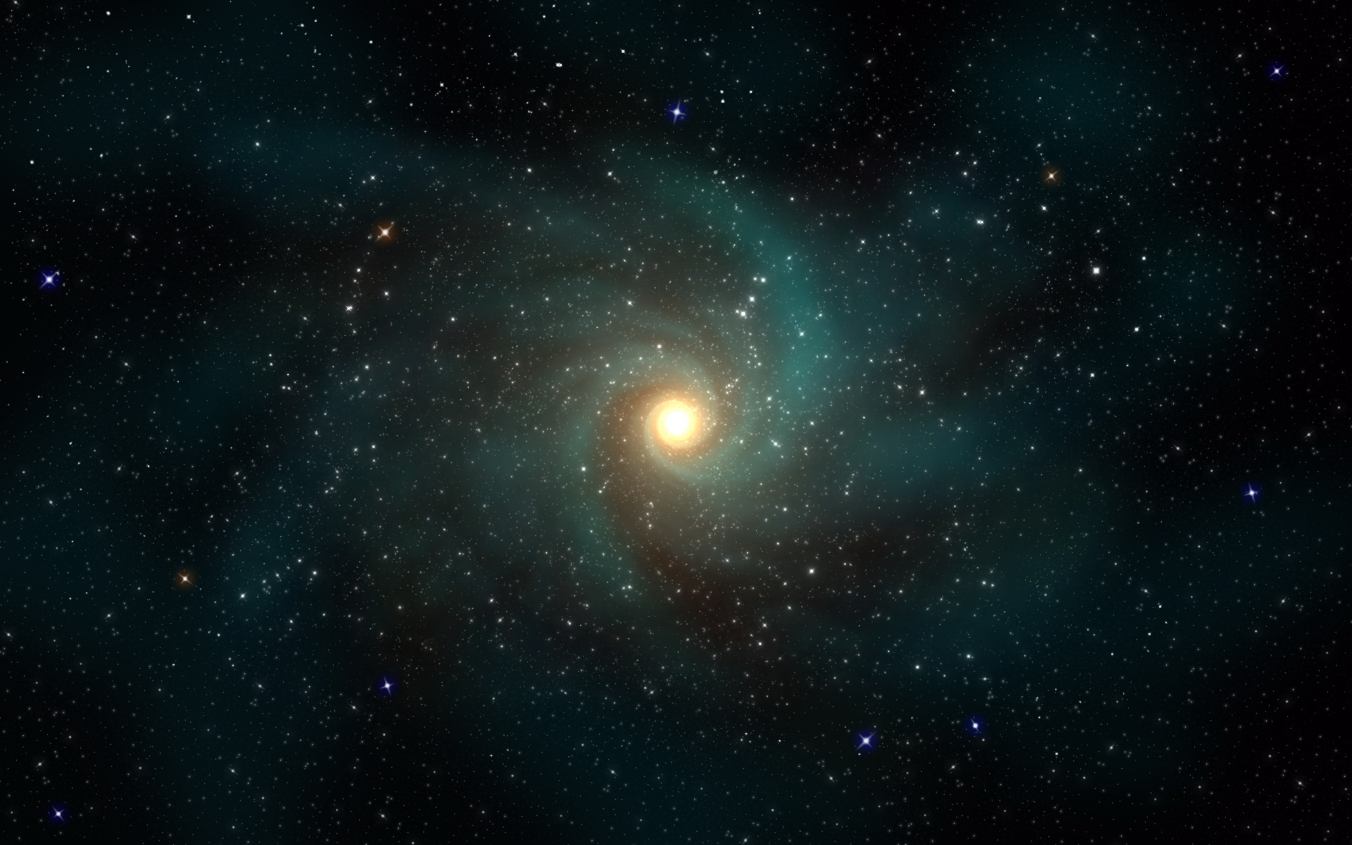
Space Wars
Press SPACEBAR to start

Slide 4
